Slide 1

vibration Analytics
Always better

Slide 2
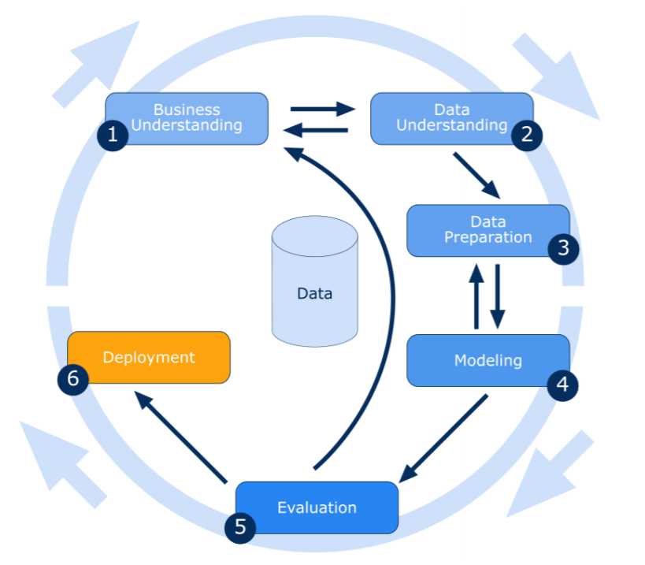
Approach/Framework
1
To understand business objectives and data mining goals to frame the problem and define success criteria
2
To explore and familiarize yourself with the data, assessing its quality and relevance for analysis
3
To Clean, preprocess, and transform the data to make it suitable for modeling.
4
To develop and test predictive or descriptive models using various algorithms and techniques
5
To assess model performance against business objectives and select the best-performing models
6
To Implement and integrate the model into the operational system for decision-making.

Slide 3
Business Understanding
We will use the NASA Acoustics and Vibration Database vibration sensor readings as our dataset for this study.
In the NASA study, sensor readings were taken on four bearings that were run to failure under constant load over multiple days.
Anomaly Detection
Anomaly detection is the task of determining when something has gone astray from the “norm”.
Anomaly detection using neural networks is modeled in an unsupervised / self-supervised manner; as opposed to supervised learning, where there is a one-to-one correspondence between input feature samples and their corresponding output labels.
The presumption is that normal behavior, and hence the quantity of available “normal” data, is the norm and that anomalies are the exception to the norm to the point where the modeling of “normalcy” is possible.
The goal is to predict future bearing failures before they happen.

Slide 4
Data Understanding - Descriptive
Bearing1
Bearing2
Bearing3
Bearing4
Numerical
year
month
day

Slide 5
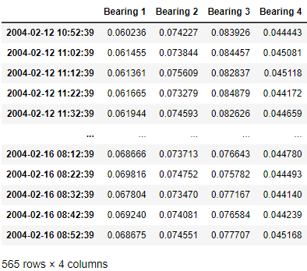
Data Understanding - Descriptive
Total Bearing
4
Duration
12/2/2004 to 16/2/2004
Our dataset consists of individual files that are 1-second vibration signal snapshots recorded at 10-minute intervals.
Each file contains 20,480 sensor data points per bearing obtained by reading the bearing sensors at a sampling rate of 20 kHz.

Slide 6
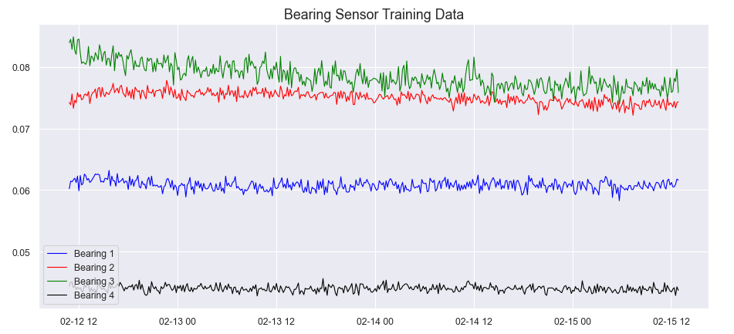
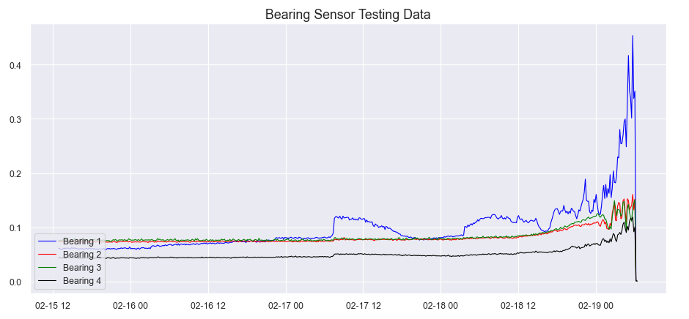
Data Understanding - Diagnostic
The training set sensor reading contains normal operating condition of the bearing
The testing set in the midway starts to change, near the failure point, the bearing vibration readings become much stronger and oscillate wildly.

Slide 7
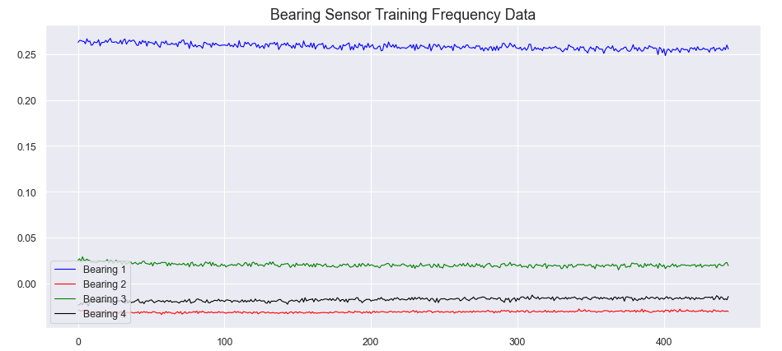
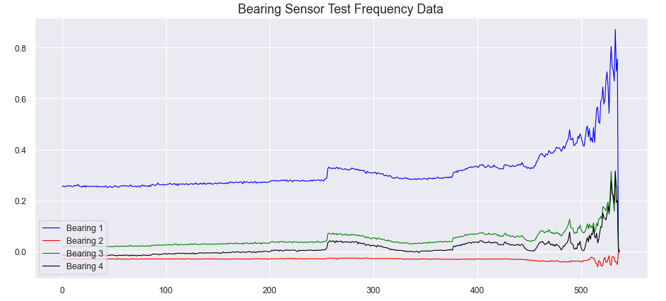
Data Understanding - Diagnostic
To understand the data in a different perspective, let’s observe the train and test set in the frequency domain while the previous slide shows about time domain.
We can clearly see an increase in the frequency amplitude and energy in the system leading up to the bearing failures.

Slide 8
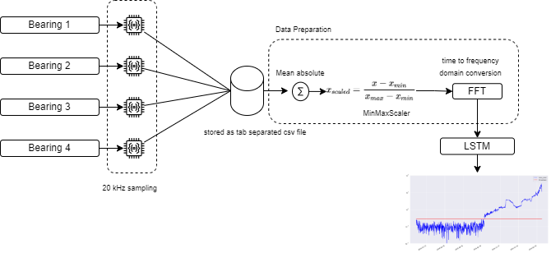
Data Preparation
To complete the pre-processing of our data,
we will first normalize it to a range between 0 and 1.
Then we reshape our data into a format suitable for input into an LSTM network.
LSTM cells expect a 3-dimensional tensor of the form
[data samples, time steps, features]
Here, each sample input into the LSTM network represents one step in time and contains 4 features
— the sensor readings for the four bearings at that time step

Slide 9
EDA - Descriptive & Diagnostic Summary
The testing set in the midway starts to change, near the failure point, the bearing vibration readings become much stronger and oscillate wildly.
We can clearly see an increase in the frequency amplitude and energy in the system leading up to the bearing failures.

Slide 10
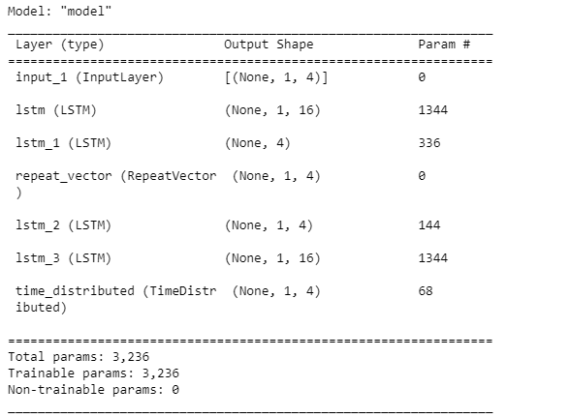
Modelling – LSTM
The model is built using the autoencoder architecture which has an encoder and decoder.
The LSTM layers are utilized for encoding where the values are reduced to lower dimensionality representation, often called latent space, while the decoder aims to reconstruct the original input from this latent representation.
So, the combination of the LSTM layers and the autoencoder concept is used for tasks such as sequence-to-sequence prediction, anomaly detection, and time-series data reconstruction.

Slide 11
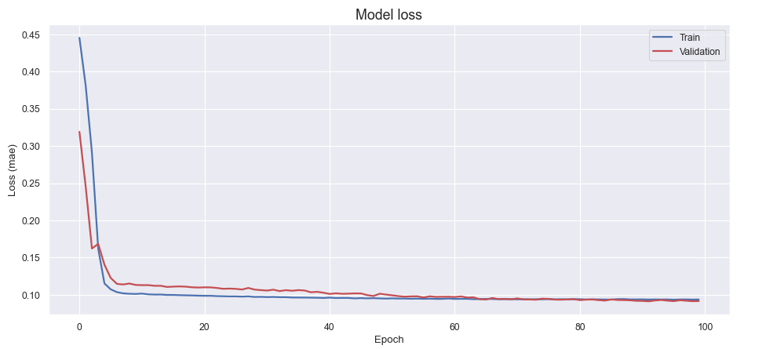
Modelling – Evaluation
Train – The depiction of how well the training data is learning.
As the epoch increases, we can observe the training loss decreases but that is guaranteed when we see validation loss is also decreasing which means the model is generalizing well.

Slide 12
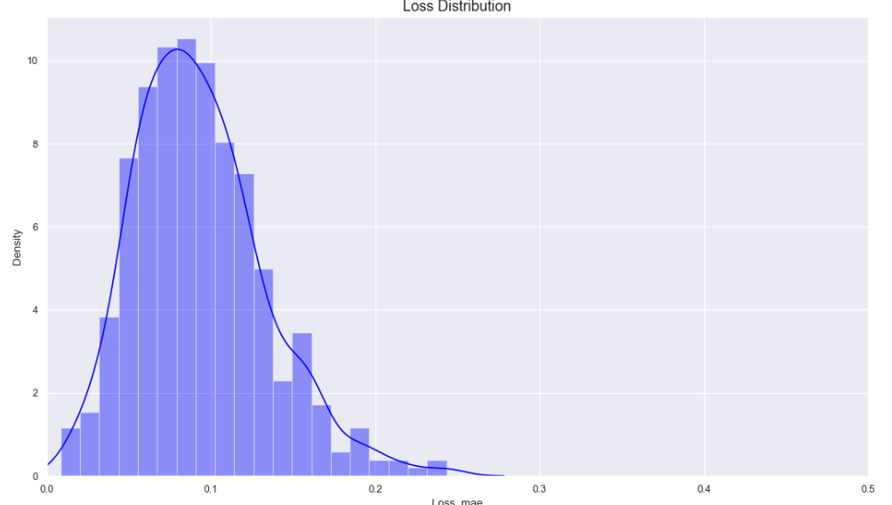
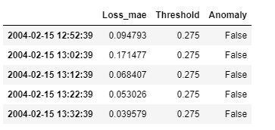
Modelling – Evaluation
Train – The depiction of how well the training data is learning.
As the epoch increases, we can observe the training loss decreases but that is guaranteed when we see validation loss is also decreasing which means the model is generalizing well.
From the above loss distribution, let's try a threshold value of 0.275 for flagging an anomaly. We can then calculate the loss in the test set to check when the output crosses the anomaly threshold.

Slide 13
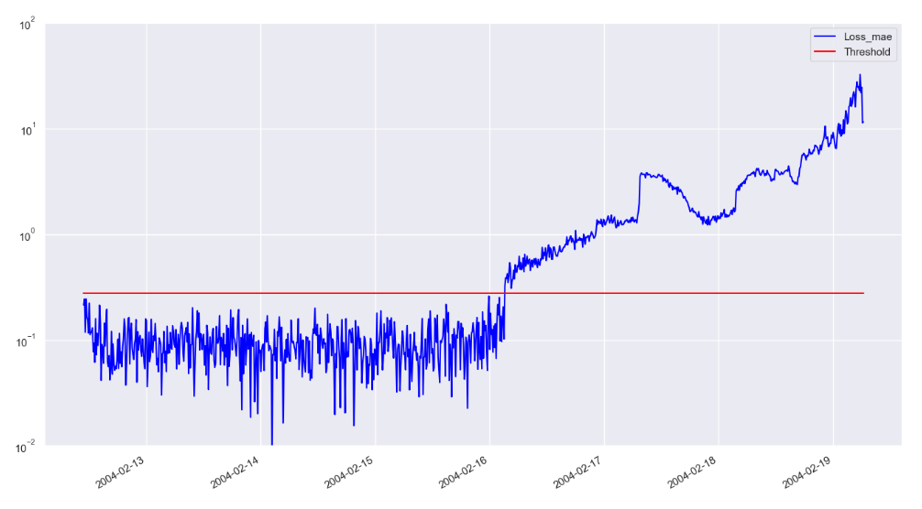
Modelling – Evaluation
This analysis approach can flag the upcoming bearing malfunction well in advance of the actual physical failure. It is important to define a suitable threshold value for flagging anomalies while avoiding too many false positives during normal operating conditions

